Slide 1

NCCDPHP
Data Insight Platform
Sprint 0 Planning & Roadmap (Discussion Only)

Slide 2
Table of Contents
Key Goals
Current State / Future State
NCCDPHP DIP Data Lake
Platform Architecture
Functional Use Case
Risks and Concerns
Roadmap
8 Week Roadmap
Technology Accelerators
Appendix: Guiding Principles & Accelerators
Application Development
Operations
Cloud Infrastructure
Data Engineering
Collaboration

Slide 3
Goals & Objectives
Key Goals
GOALS
DESIRED OUTCOMES
Set the standards for web development and data science
Deliver excellent technology products that meet our clients needs through the application of effective technology implementation standards
Provide a better technology experience
Provide applications that are visually appealing, intuitive to use, and development processes that invite client interaction and involvement.
Modernize Critical and Core Public Health Components and Processes
Create modern data services that enhance the ability of leaders to execute public health policy and surveillance activities
Applications that exceed client expectations in terms of usability and intuitiveness
Applications and analytics products integrated with client decision making processes
Consistent high-touch client interactions throughout the development process
Develop data management service program to accelerate data collaboration and discovery
Develop data analytic and ML services program enabling predictive insights for business leaders within NCCDPHP
Key Taskforce:
Delivering web applications and analytics
Implement data lake data processing capabilities
Building analytics workbench services
Notes:
Takeaway outcomes and taskforce:
Delivering web applications and analytics
Building data lake ingestion and storage services
Building analytics workbench
Other desired outcomes, operationally:
Stabilize operations within infrastructure to improve output quality and reduce solution downtime
Optimize resource time allocation to allow resources to dedicate more time to production priorities
Expand solution functionality and stability through testing and iterations
Automate manual work across the development lifecycle
Reduce redundancy across data hosting environment to focus

Slide 4
Current State
Key Goals
Container hosting and data warehouse bottleneck the data capabilities offered. Analytics must be done locally and manually imported into warehouse for processing. Efforts and technology are disjointed in interactivity, requiring higher levels of effort to administer and oversee.
Visualizations and reports are built using custom (often local) solutions, requiring additional knowledge and setup.
Data Sources
Semi-structured, and Structured data ingested from internal/external sources
Ingestion Service
Storage
Data Analytics
Ingestion pipeline must transform data into structured schema
Enterprise data warehouse for data mart, shared by Applications and Analytics
Analytics must be completed locally
Ingestion Service
Systems and End-Users
Provider APIs
Data Warehouse
Custom systems or reporting/visualization tools can access data services or storage.
Local Analytics
Systems & Custom Applications
Batch
ETL Scripts
Manual Scripting
All ETL pipelines must have coded ETL scripts

Slide 5
Future State: Conceptual Architecture
Key Goals
Utilize cloud native services to enable scalable storage for diverse datasets and analytic capabilities. Leverage compute, catalog, search, and reporting/visualization services to accelerate to market
Data Services
Data Sources
Big data processing, search, and automatic catalog services to enable discoverability and insights
Unstructured, Semi-structured, and Structured data ingested from internal/external sources
Systems, Subscribers, Users
Storage
Systems or reporting/visualization tools can access data services or storage.
Highly scalable enterprise data warehouses for data mart or performant analytic usages
Data Pipeline Orchestration
Create, schedule, orchestrate, and manage data pipelines and ETL
﻿﻿
Data Analytic Platform
Stream Data
Data Warehouse
Provider APIs
Data Orchestration Pipeline
Data Catalog
Data Reporting & Visualizations
Big Data Storage
Batch
Search Engine
Systems & Custom Applications
Governance
Security
Governance, Security Hardening
Enterprise ready security and governance for data storage, usage, and compliance.

Slide 6
Future State: Phase 1
Key Goals
Utilize cloud native services to enable scalable storage for diverse datasets and analytic capabilities. Leverage compute, catalog, search, and reporting/visualization services to accelerate to market
Data Sources
EDAV
Unstructured, Semi-structured, and Structured data ingested from internal/external sources
Systems, Subscribers, Users
Storage
Systems or reporting/visualization tools can access data services or storage.
Highly scalable enterprise data warehouses for data mart or performant analytic usages
Data Pipeline Orchestration
Create, schedule, orchestrate, and manage data pipelines and ETL
﻿﻿
ECPaaS
Stream Data
Azure SQL Postgres
Data Insight Platform Custom Apps
Provider APIs
Azure Data Factory
Azure Lake Gen Data2
Data Insight Platform Tableau / Power BI
Batch
Governance
Security
Governance, Security Hardening
Enterprise ready security and governance for data storage, usage, and compliance.

Slide 7
Future State: Phase 2
EDAV
Analytics Workbench
Data Catalog
Key Goals
Data Bricks / Synapse Analytics
Data Analytic Training
Data Analytic Prediction
Search Engine
EDAV
Data Sources
Storage
Highly scalable enterprise data warehouses for data mart or performant analytic usages
Unstructured, Semi-structured, and Structured data ingested from internal/external sources
Systems, Subscribers, Users
Systems or reporting/visualization tools can access data services or storage.
Data Pipeline Orchestration
Create, schedule, orchestrate, and manage data pipelines and ETL
﻿﻿
Azure Synapse
ECPaaS
Stream Data
Azure SQL Postgres
Data Insight Platform Custom Apps
Provider APIs
Azure Data Factory
Azure Lake Gen Data2
Data Insight Platform Tableau / Power BI
Batch
Governance
Security
Governance, Security Hardening
Enterprise ready security and governance for data storage, usage, and compliance.

Slide 8
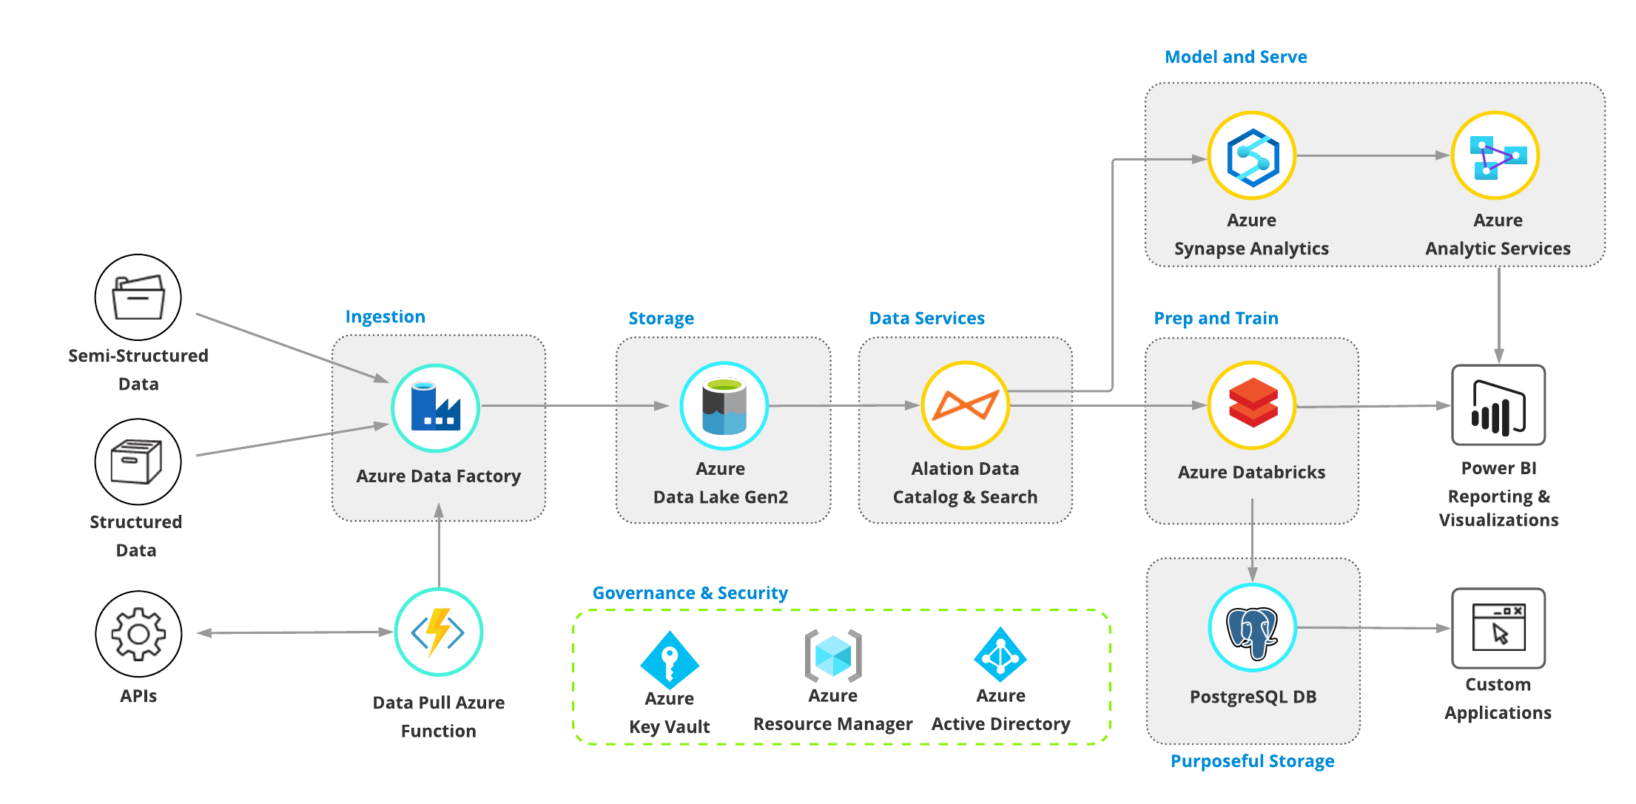
Future State: Platform Conceptual Architecture
NCCDPHP DIP Data Lake
Data Analytics Platform
Leverage unified synapse service for data integration, enterprise data warehousing, and big data analytics.
Data Sources
Unstructured, Semi-structured, and Structured data ingested from internal/external sources
Data Pipeline Orchestration
Data Services
Create, schedule, orchestrate, and manage data pipelines and ETL
Search and automatic catalog services to enable discoverability and insights
Machine Learning
Use scalable machine learning/deep learning techniques, to derive deeper insights
Systems, Subscribers, Users
Systems or reporting/visualization tools can access data services or storage.
Assumption: Data lifecycle is often non-linear, and users can engage at different stages
Notes:
Tags: process, current state

Slide 9
NCCDPHP Data Insights Platform: Functional Use Case Categories
NCCDPHP DIP Data Lake
Categories | Functional Use Cases (To Be Filled)
Public Health Surveillance | Non-infectious Disease Surveillance National Diabetes Surveillance Behavior Risk Factor Surveillance
Public Datasets | Geographic Assets Public Funding Grants
Electronic Case Reporting | …..
Electronic Lab Reporting | …
Vital Stats | …
Outbreak Data Collection | COVID-19 Data
Healthcare Data Acquisition | …
Health Surveys | American Community Survey
Case Notification | …
State Registries | ….
Social Media | CDC Program Twitter Presence Web Metrics Google Trends
Third-party Data Acquisition | Movement Data

Slide 10
NCCDPHP Data Insights Platform: Primary Use Cases (TBD)
 | Use Case Placeholder | Use Case Placeholder | Use Case Placeholder | Use Case Placeholder | Use Case Placeholder | Use Case Placeholder
Use Case | Use Case 1 Description | Use Case 2 Description | Use Case 3 Description | Use Case 4 Description | Use Case 5 Description | Use Case 6 Description
Data Sources | Source Name Source Name 2 | Source Name Source Name 2 | Source Name Source Name 2 | Source Name Source Name 2 | Source Name Source Name 2 | Source Name Source Name 2
Frequency | Ad-hoc, Annual, Monthly | Ad-hoc, Annual, Monthly | Ad-hoc, Annual, Monthly | Ad-hoc, Annual, Monthly | Ad-hoc, Annual, Monthly | Ad-hoc, Annual, Monthly
Data Pipeline Orchestration | Batch Incremental On-premises system transfer Stream | Batch Incremental On-premises system transfer Stream | Batch Incremental On-premises system transfer Stream | Batch Incremental On-premises system transfer Stream | Batch Incremental On-premises system transfer Stream | Batch Incremental On-premises system transfer Stream
Storage & Processing | Structure: Semi-structured Structured Unstructured Store: Relational DB NoSQL / Document Data analytic DB | Structure: Semi-structured Structured Unstructured Store: Relational DB NoSQL / Document Data analytic DB | Structure: Semi-structured Structured Unstructured Store: Relational DB NoSQL / Document Data analytic DB | Structure: Semi-structured Structured Unstructured Store: Relational DB NoSQL / Document Data analytic DB | Structure: Semi-structured Structured Unstructured Store: Relational DB NoSQL / Document Data analytic DB | Structure: Semi-structured Structured Unstructured Store: Relational DB NoSQL / Document Data analytic DB
Data Services | Data catalog Power BI / Tableau Data Bricks / Spark / Python / R | Data catalog Power BI / Tableau Data Bricks / Spark / Python / R | Data catalog Power BI / Tableau Data Bricks / Spark / Python / R | Data catalog Power BI / Tableau Data Bricks / Spark / Python / R | Data catalog Power BI / Tableau Data Bricks / Spark / Python / R | Data catalog Power BI / Tableau Data Bricks / Spark / Python / R
Systems, Subscribers, User

Slide 11
Risks & Mitigation
Risks/Concerns | Mitigation
​Complex footprint and landscape (Several programs with diverse data pipelines)​ Existing Cloud landscape (multi-Cloud environments) with multiple data hubs in mix​ | Program Readiness Assessment Identify program candidates for pilot adoption Impact to existing workflows Lake-to-Lake data opportunities. Data Compliance/Regulatory Req.
Enterprise Data Hub development and implementation is ongoing | Engage and collaborate with OCIO team Involve OCIO team early in development
Organization Change Management and adoption ​ | Organize plan for change management and adoption Identify data lake owner/champion Develop communication and rollout plan with functional specifics. Roll-out plan should include: Implementation Plan Onboarding Guidelines Use Case Guidelines
Organization capability, financial models, resources, and support model​ | Outline support and shared responsibility model between programs and enterprise

Slide 12
Eight Week Roadmap
Roadmap
Week | 0 | 1 | 2 | 3 | 4 | 5 | 6 | 7 | 8
Project Preparation
Application/Services Restoration Develop and test Database-as-a-Code services Preliminary Discussion (organize workforce, objectives , and tasks) Project Kickoff
Baseline Objectives & Evaluation
Establish key client objectives (connect with Tim/Melvin/Jonathan) Stakeholder pod alignment Data Lake options evaluations and decision Web Application requirements & development
Web Application Short Term Plan
Chronic Use Case 1 Development Chronic Use Case 2 Requirements & Development
Data Lake Short Term Plan
Data Lake requirements & primary NCCDPHP use cases Develop Cloud Platform specific Architecture Change management and adoption plan Communication / Roll-out plan Cloud Data Lake Development / Testing
Long Term Roadmap
Program readiness assessment Cloud Data Lake Rollout Analytics Workbench Development
Web App 1 Production
Requirements, Architecture, Primary Use Case

Slide 13
Staffing
Week
Project Preparation
Application/Services Restoration Develop and test Database-as-a-Code services Preliminary Discussion (organize workforce, objectives , and tasks) Project Kickoff
Baseline Objectives & Evaluation
Establish key client objectives (connect with Tim/Melvin/Jonathan) Stakeholder pod alignment Data Lake options evaluations and decision Web Application requirements & development
Web Application Short Term Plan
Chronic Use Case 1 Development Chronic Use Case 2 Requirements & Development
Data Lake Short Term Plan
Data Lake requirements & primary NCCDPHP use cases Develop Cloud Platform specific Architecture Change management and adoption plan Communication / Roll-out plan Cloud Data Lake Development / Testing
Long Term Roadmap
Program readiness assessment Cloud Data Lake Rollout Analytics Workbench Development

Slide 14
Infrastructure Development Task Force
Data Lake/Hub
Use Case Identification / Guidance for Programs/Center
Data Clearance / Providers
Ingestion/Collection Pipelines
Metadata Cataloging
Structured/Unstructured Blob Storage
Purposeful Database
Data Resilience Operating Model
DevOps
Continuous Integration Pipeline in ECPaaS and AWS
Unit Testing
Database version control services
Utilizing and Optimizing Kubernetes
Maintaining Openshift Environment
Maintaining Continuous Deployment Pipeline in ECPaaS and AWS
Data Workbench
Building / maintaining out Big Data / Analytics Database (e.g. Cosmos, RedShift) in Azure
Building / maintaining big compute platform (Data Bricks, Synapse) in Azure
Working with DevOps to explore data CI/CD model
Infrastructure Development Task Force
Data Lake/Hub
6-8 Weeks
2x Data Engineers (Pipeline development)
1x Azure Cloud Engineer
DevOps
4-6 Weeks
1x DevOps Engineer (Cloud Background)
Data Workbench
4-8 Weeks
1x Azure Senior Cloud Engineer

Slide 15
Technology Accelerators
Roadmap
Supplementary technology work that will accelerate roadmap delivery
Team: Develop guiding principles across application development, infrastructure, operations, and collaboration
Reduce Manual Work: Establish and consolidate code projects on CDC Enterprise GitHub to minimize redundancies
Migrate: Deploy applications on new ECPaaS Environment (OpenShift 4)
Security: SSO Implementation
Investigate inbuilt Azure Active Directory instead of Keycloak
Time-to-Prod: Implement CI/CD within CDC environment to improve release quality and accelerate time to production
Testing: Expand application unit testing coverage to improve code and release quality

Slide 16
Appendix

Slide 17
Infrastructure Environment: Future State
CDC Cloud Platform
Data Services
Big data processing, search, and automatic catalog services to enable discoverability and insights
Cloud IaaS as the data infrastructure
Container PaaS as the application infrastructure
Data Pipeline Orchestration
Create, schedule, orchestrate pipelines for unstructured and structured data
Data Analytics
Analytic and machine learning capabilities offering Notebook, Big Data Compute, and frameworks
Stream Data
Data Orchestration / Processing
Data Reporting & Visualizations
CDC Container Orchestration
Provider APIs
Ingestion Pipeline
Object Storage
Data Catalog
Data Analytics Platform
Storage
Highly scalable enterprise data warehouses for data mart or performant analytic usages
Batch
Search Engine
Systems & Custom Applications
Purposeful
Data Warehouse
Firewall
Code Repository
Build Service

Slide 18
Cloud Infrastructure
Key Questions
What are our options and roadmap for CDC cloud platform?
How can we reduce costs across environments
Deloitte Dev
CDC Dev/Prod
What processes can springboard new application pods?
How can we reduce infrastructure maintenance?
What are our cloud resources that are compatible/incompatible with other cloud vendors?

Slide 19
Data Processing and Analytics: Future State (WIP)
Analytics Workbench
Stream Data
Data Stream Capture
Raw
Data Catalog
Processed
Provider APIs
Ingestion Pipeline
Data Orchestration / Processing
Data Analytic Training
Data Analytic Prediction
Analytics Data Store
Search Engine
Object Storage
Data Lakes
Purposeful
Data Warehouse
Data Reporting & Visualizations
Batch
Data Pipeline Orchestration
Storage
Data Analytics
Create, schedule, orchestrate pipelines for unstructured and structured data
Highly scalable enterprise data warehouses for data mart or performant analytic usages
Analytic and machine learning capabilities offering Notebook, Big Data Compute, and frameworks

Slide 20
Data Processing and Analytics
Key Questions
What are success factors for establishing a data lake solution in core areas
Ingestion
Storage
Processing
What are key factor for establishing data analytic capabilities in core areas?
Machine Learning
Big Data
Cloud Analytics Computing
Reporting & Visualization

Slide 21
Operations Lifecycle: Current State
Pain Points
Manual Deployments result in server troubleshooting and overhead
Develop must copy code and synchronize two repositories
Developer/Data team has to move data from Deloitte to CDC network and also ensure that any additional CDC data is replicated to Deloitte
Security Scan not effectively used within development iterations resulting in bottleneck for production
App must be deployed and maintained in Test environment, despite low usage and similar version as DEV
Deloitte AWS
CDC
CDC Cloud
EC2 Deployment
CDC ECPaaS 3.X
Local Development
Self-Hosted GitLab
CDC Enterprise GitLab
ECPaaS Dev
ECPaaS Test
Security Scan
ECPaaS Production
Developer
Submits new code changes
Copy Repository to CDC
DevOp Config & Deploy
DevOp Config & Deploy
Submit to ECPaaS for deployment
Copy Ingested Data to Deloitte
Dev is used by Dev/Test Apps
Data Sources
AWS RDS - Postgres
Postgres Dev
Postgres Production
Data / App Team
Adds new data
Date / App / DevOp Team
Copies data
Ingestion Service

Slide 22
Operations Lifecycle: Current State
Legacy
CDC ECPaaS 3.X
Hosted on AWS
Current/Future
CDC ECPaaS 4.X
Hosted on Azure (ARO 4)
Pain Points
Manual Deployments result in server troubleshooting and overhead
Develop must copy code and synchronize two repositories
Developer/Data team has to move data from Deloitte to CDC network and also ensure that any additional CDC data is replicated to Deloitte
Security Scan not effectively used within development iterations resulting in bottleneck for production
App must be deployed and maintained in Test environment, despite low usage and similar version as DEV
Deloitte AWS
CDC
CDC Cloud
EC2 Deployment
CDC ECPaaS 3.X
Local Development
Self-Hosted GitLab
CDC Enterprise GitLab
ECPaaS Dev
ECPaaS Test
Security Scan
ECPaaS Production
Developer
Submits new code changes
Copy Repository to CDC
DevOp Config & Deploy
DevOp Config & Deploy
Submit to ECPaaS for deployment
Copy Ingested Data to Deloitte
Dev is used by Dev/Test Apps
Data Sources
AWS RDS - Postgres
Postgres Dev
Postgres Production
Data / App Team
Adds new data
Date / App / DevOp Team
Copies data
Ingestion Service

Slide 23
Operations Environment Lifecycle: Future State
Optimize path to production
Remove CDC GitLab from development iterations. Copy when going to production
Decommission TEST resources and merge into Dev
Transition from Deloitte database to CDC cloud database as primary store for DEV
Reduce reliance on persistent Deloitte Demo environment by (TBD)
Reduce Manual Deployment
Transition to cloud containerized services and containerize existing apps
Reduce operations overhead
Migrate to CDC GitHub to reduce team overhead and unneeded replication
Improve database durability, availability, and resilience
Transition away from database containers. Utilize existing CDC cloud platform to build persistent database
Deloitte AWS
CDC Enterprise & Cloud
ECS Deployment
CDC ECPaaS
Local Development
CDC GitHub
ECPaaS Dev
Security Scan
ECPaaS Production
DevOp Config & Deploy
Submit to ECPaaS for deployment
Developer
Submits new code changes
CDC Cloud Purposeful Databases
Date / App / DevOp Team
Copies data
Data Sources
Ingestion Service
Postgres Dev
Postgres Production

Slide 24
Data Resilience, Durability, and Availability

Slide 25
Operations
Key Questions
What processes are impeding time to deployment (dev/prod, scans, etc)?
What are best practices we need to automate manual tasks?
How can we consolidate procedures and support to improve efficiency?
How can we improve redundancy and fault tolerance in data and application stacks?

Slide 26
Application Development
Guiding Principles & Accelerators
Measurement | Objective
Test Coverage | Increase test Coverage every version
Automated Code Review | Lint Free
Peer Code Review | Review Turnaround <2 Business days
Bugs | Decrease number of bugs every version
Time to Prod | 1 Month (TBD)
Key Questions
What processes are impeding development?
What knowledge sharing/transition needs to occur for each pod?
What are methods for delivering quality code across all pods?
What best practices are essential for delivering products (versioning/tagging, checkpoints, etc.)
Guiding Principles
Aim for high test coverage to improve quality and reduce issues during integration
Set standards for peer review to create consistent code
Automate code standards to improve readability and review
Document code for knowledge sharing and understandability
Apply version control to releases and milestones

Slide 27
Current State: Application Lifecycle
Agile
Iterate through sprints and user stories
Plan
Develop
Build
Functional Test
Deploy
Operate
6 Months (?) Between Production Deployment
Manual Testing
Manually test features and code
Deployments are held by SDLC requirements and late security scans. Compounded by growing user stories

Slide 28
Future State: Application Lifecycle
Automatic Build
Automatic Testing
Release
Deploy
Automate builds to ensure issues are discovered early
Automate unit and integrate tests to ensure code quality. Integrate security scan testing
Build releases for version control
Streamline deployment workflow and SDLC process to deploy quickly into production
Continuous Integration
Continuous Deployment
Plan
Develop
Build
Functional Test
Automated Test
Security Test
Release
Deploy
Operate
2 Weeks Between Production Deployment
Production deploying will be one sprint behind.
Create, schedule, orchestrate, and manage data pipelines and ETL

Slide 29
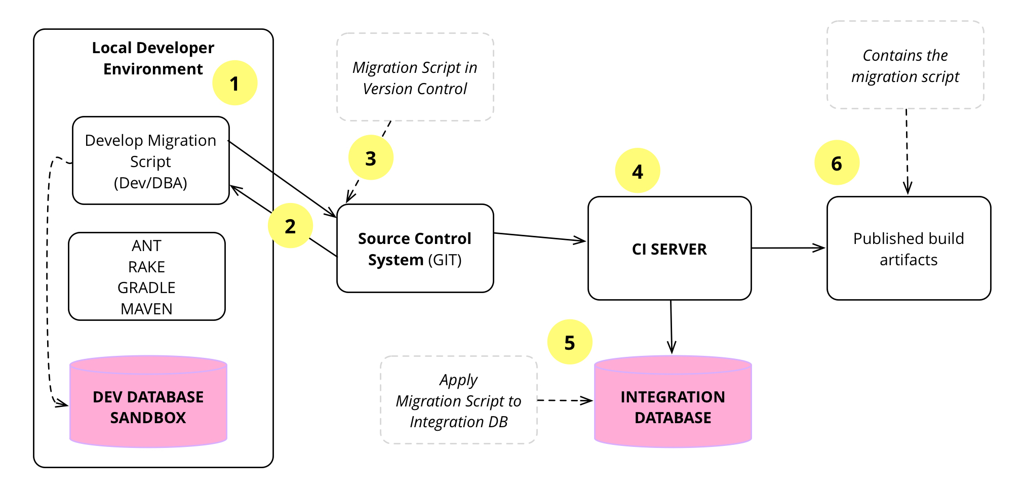
Database as a Code
Development Process (source. martinfowler.com)
Application Development
Enables Version Control to maintain consistency and allow auditing
Easily create new environments. Everything needed for new database is in a single repository
Prevent deployments where database is out of sync with application
Central place to look, making it easier for developers to find
Development Setup
Deployed Environment
Local Environment
Application
Making Changes to Database
Develop: Developer codes database schema change to dummy database
Integrate: After local testing is complete, developer submits PR for Database Repository
Review: 2 Reviewers approve and changes are merged
Build: CI Tool detects changes and creates DB build with migration scripts
Deploy: CI Tool deploys migration scripts
Application
API Server
API Server
Dummy Database Container
Database
Master Database Repository
Postgres Docker Image

Slide 30
Containers
Application Development
Containerizing each projects allow efficient replication of environments and start-up. It captures the concept of agnostic software that can run on several environments

Slide 31
Code Review (to be filled)
Application Development
Standards for code reviewers
Standards
Example
Example
Local Development
Automated Code Review
Merge Request
Code Review
Integrate

Slide 32
Archive

Slide 33
Next Steps
Application
Containerize and Restore
Establish Dummy Database Containers
Expand Testing
Test CI Services / DB Version Control services
Operations
Organize workforce, objectives , and tasks
Contract start
Establish key client objectives
Establish project on CDC Enterprise GitHub
Deploy services on OpenShift 4
Develop CI/CD on CDC side
Discuss Cloud platform decision
Develop Cloud Platform specific Architecture
Cloud Data Lake implementation
SSO Implementation
Investigate Azure AD instead of Keycloak
Analytics Workbench

Slide 34
Platform Architecture: Future State (WIP)
Key goals
Data Analytics Platform
Data Sources
Leverage unified service for data integration, enterprise data warehousing, and big data analytics.
Unstructured, Semi-structured, and Structured data ingested from internal/external sources
Data Pipeline Orchestration
Data Services
Create, schedule, orchestrate, and manage data pipelines and ETL
Search and automatic catalog services to enable discoverability and insights
Machine Learning
Use scalable machine learning/deep learning techniques, to derive deeper insights
Systems, Subscribers, Users
Systems or reporting/visualization tools can access data services or storage.
Assumption: Data lifecycle is often non-linear and can occur in different stages
Notes:
Tags: process, current state

Slide 35
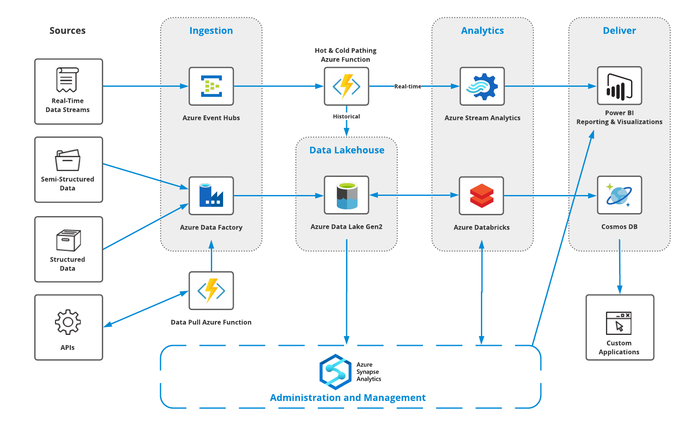
Technology & Architecture: Future State (WIP)
Key goals
​ | Technology Service​
Infrastructure​ | Azure​
Date Pipeline Orchestration​ | Data Orchestration Services: Azure Data Factory Data Push: SFTP: Direct: Data Stream Capture: Azure Event Hub
Storage & Processing​ | Object Store: Azure Blob Storage Relational Data Warehouse: Azure SQL Pools NoSQL/Document DB: ​Azure Cosmos DB Analytic Data Lakehouse: Azure Synapse Analytics Serverless Data Processing: Azure Functions
Data Analytics​ | Platform: Azure Synapse ML Frameworks: Jupyter Support:
Reporting / Visualization​ | Power BI
Security & Governance​ | IAM: Azure Active Directory Security Tools: Azure Key Vault Governance: Network:
Integration​ | Data Catalog: Search: Messaging:
Notes:
Tags: process, current state

Slide 36
Collaboration
Key Questions
How can we consolidate our communication and collaboration methods?
Potentially move current SharePoint items to Teams channels?

Slide 37
Our Mandate
Key Goals
Use Case Identification & Development
Detailed Agile Requirements Analysis
Leading Edge Software Development
Optimized Continuous Integration/Delivery
“We define, develop, and deliver advanced analytics via web applications to enhance our client’s
decision making capabilities.”
On-Demand Analytics
One-Stop Data Shop
Client Analytics Enablement
Superior User Experience
Accessible to All People
Easy to maintain/update
Technical Assistance
Grant Investments and Program Evaluation
External Communications
Policy Evaluation and Implementation
Notes:
Make analytics more accessible

Slide 38
Conceptual Application Architecture
Application Development
Three-Tier Application Architecture
Web Components
Presentation Layer
Application Server
Data
Server
Application Layer
Data Layer
Database

